Slide 1
Math 8 Chapter 10 Review

Slide 3
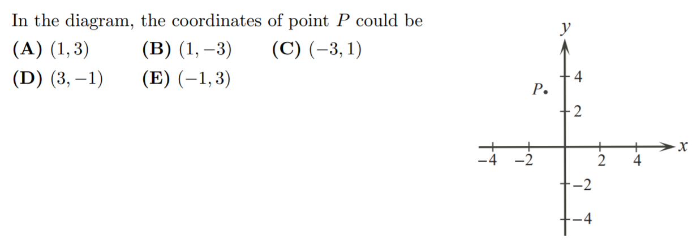

Slide 11
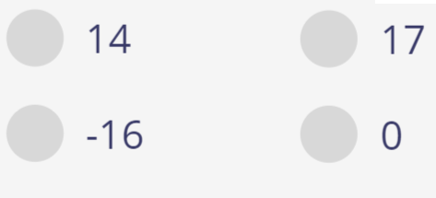
A
C
B
D

Slide 12
A
B
C
D

Slide 13
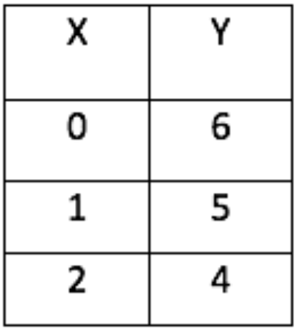
A
B
C
D

Slide 14
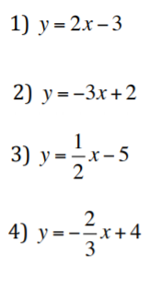
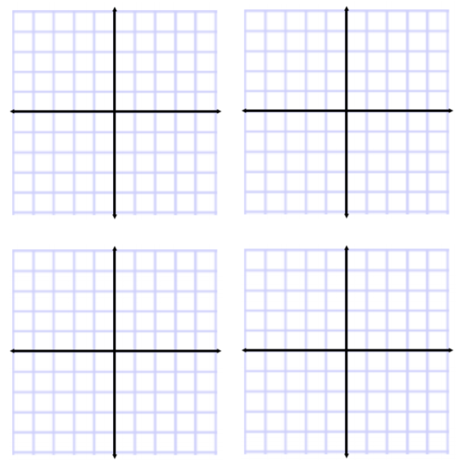
Q: Match each equation with the corresponding graph:
A
B
C
D

